Slide 1






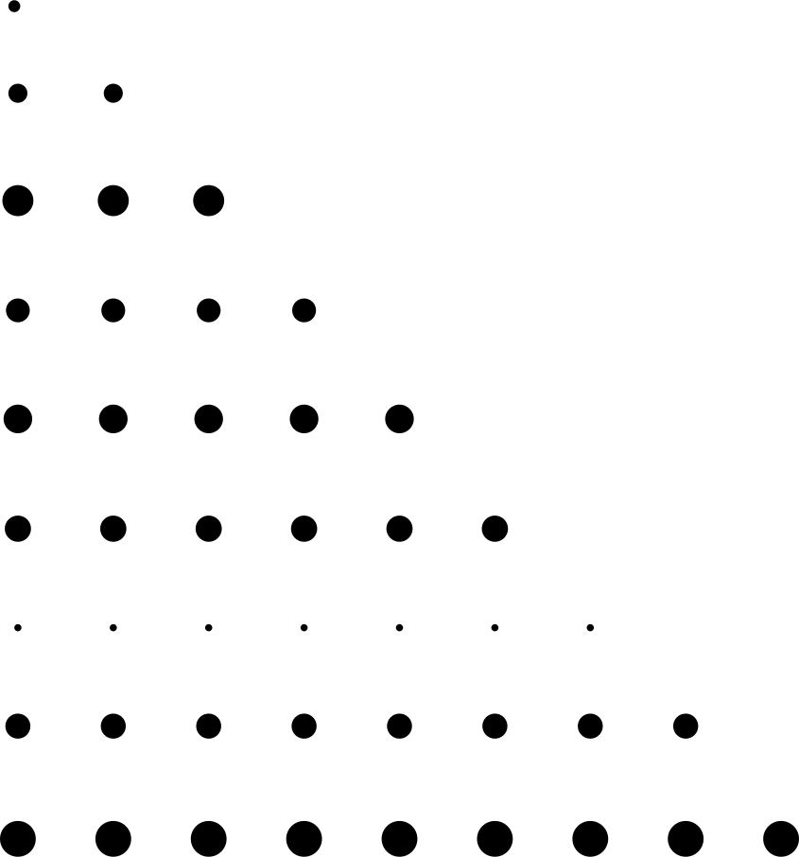
Movie Success Prediction Project
Data Science Project | Boston Institute of Analytics
76.81%
Model Accuracy
Name: Harmain Aziz

Slide 2






THE DATASET & TARGET
Foundation of the Movie Success Prediction Model
THE DATASET & OBJECTIVE
📊 Data Foundation
• Scope: 5,043 movies (1916-2016)
• Features: 28 variables analyzed (budget, gross, social likes, etc.)
• Goal: Build a classifier to predict a movie's success category.
🎯 Defining 'Success'
Movies were categorized based on IMDB score:
• 🏆HIT (6-10): 3,458 movies (68.5%)
• ⚖️ AVERAGE (3-6): 1,539 movies (30.5%)
• 🚫 FLOP (1-3): 46 movies (0.9%)
Average
Flop
Hit

Slide 3
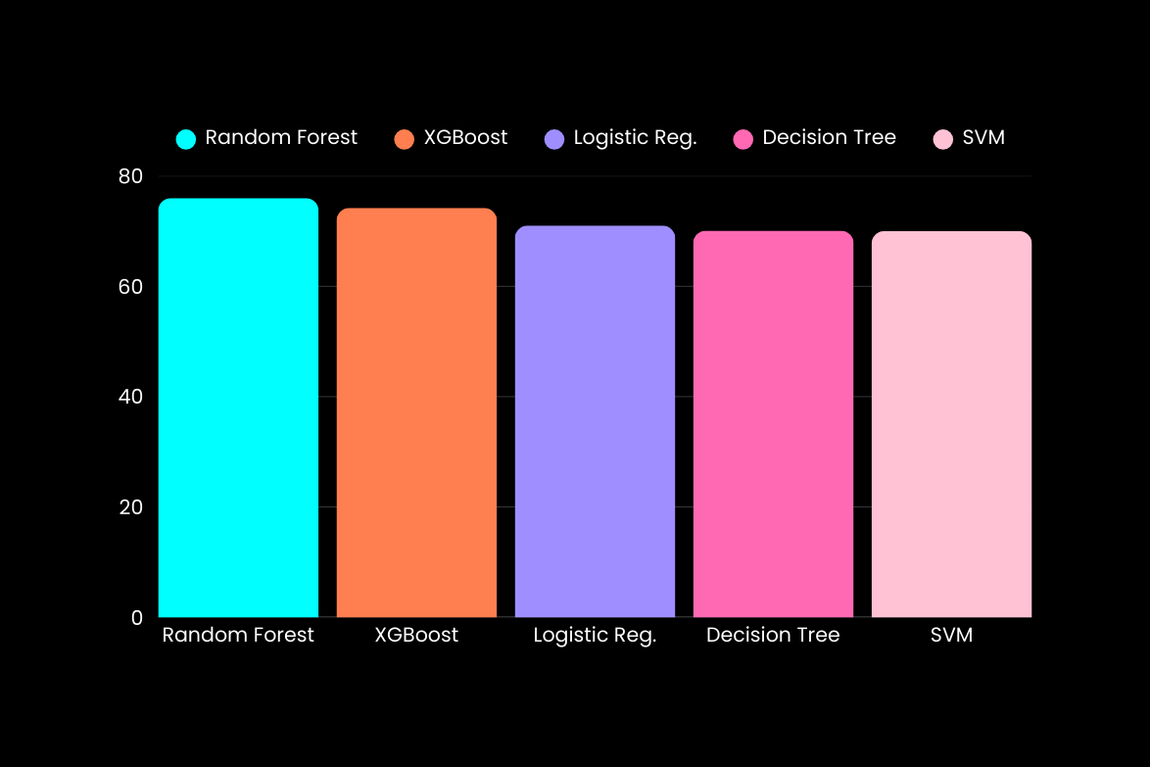
Analysis: What Predicts Success?
Model Accuracy Comparison
76.8
74.2
71.5
70.1
70.8
The Random Forest model identified clear patterns. The number of audience votes, movie duration, and budget are the strongest signals of a film's IMDB score.
Key Driver: Audience Engagement
The 'num_voted_users' feature was the most important predictor, accounting for 24.3% of the model's decision. This suggests active audience engagement is a primary indicator of success.

Slide 4

What Drives Success? Feature Importance
The Top Predictors
1. Num of Voted Users → 24.3%
2. Movie Duration → 19.1%
3. Gross Earnings → 16.0%
4. Budget → 15.9%
5. Director FB Likes → 13.4%
24.3
19.1
Audience engagement is the #1 predictor. The model shows that how many people vote 24.3% is a stronger signal of success than the movie's budget or star power.
16.0
15.9
13.4

Slide 5







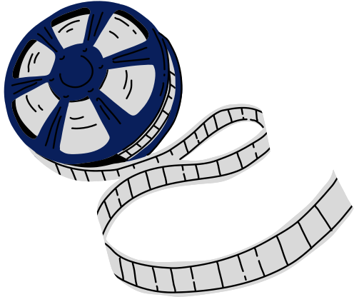

From Data to Strategy
Actionable insights for film studios
Prioritize Audience Engagement
The #1 predictor 24.3% is audience votes.
→ Shift marketing to drive ratings & reviews.
Use Predictive Analytics Early
Budget & gross form a ~32% success signal.
→ Score projects with the model before approval.
Optimize The Production Formula
Movie duration is a key lever 19.1%.
→ Target runtimes within 90-150 minutes.

Slide 6







Production & Investment
Marketing & Engagement
Conclusion & Strategic Roadmap
• Score projects before approval
• Allocate budget by success probability
• Target 90-150 minute runtime
• Drive social engagement
• Target audience votes
• Budget by confidence
This data-driven framework helps studios reduce risk and optimize investments using 76.81% accurate predictions.
Future Development
Deployment Plan
• Add real-time social media tracking
• Include streaming platform data
• Build region-specific models
Integrate into project workflow
Train teams on dashboard use
Pilot with upcoming productions
Monthly model updates

Slide 7







Project - 2025
Thank You
Email:
Institute:
battleofbrain10@gmail.com
Boston Institute Of Analytics

